Slide 1
Capstone Project
Topic Modeling on News Articles

Slide 2
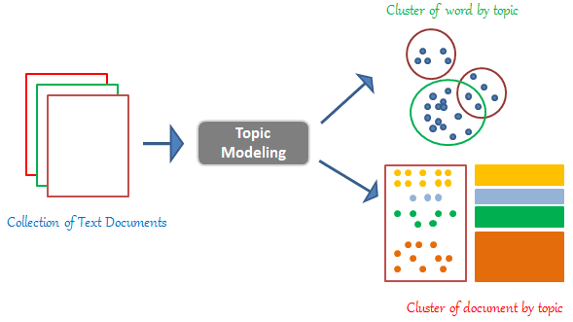
Content
Problem statement
Data Summary
Data Preprocessing
Feature Extraction
ML Models
Challenges
Conclusion

Slide 3
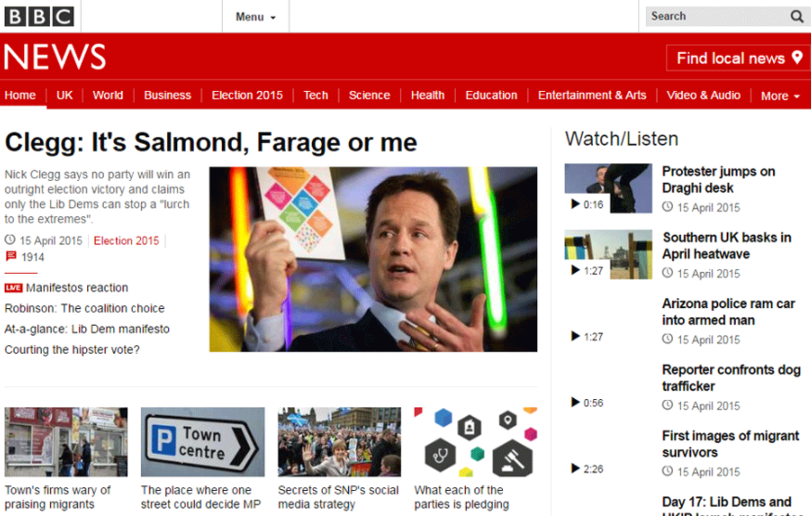
Problem Statement
Identify major themes/topics across a collection of BBC news articles using different topic modeling techniques.

Slide 4
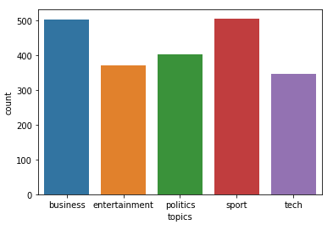
Data Summary
There are total 5 topics -
Business
Entertainment
Politics
Sports
Technology
Dataset consists of total 2225 articles.

Slide 5

Data Pre-processing
Remove Html tags and urls
Convert accented characters to ASCII characters
Remove punctuations
Remove numbers
Split attached words
Remove small length words
Remove extra whitespaces
Spelling corrections
Lemmatization
Remove stopwords
Remove frequent words

Slide 6
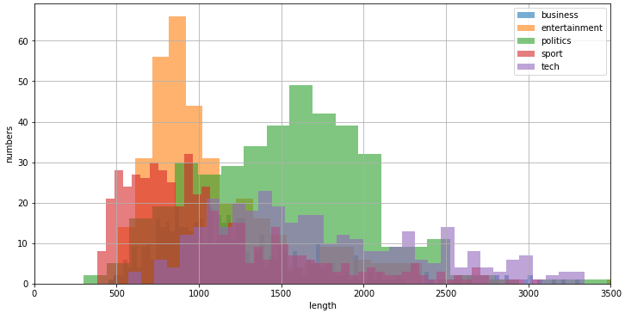
Feature Extraction - Length of documents

Slide 7
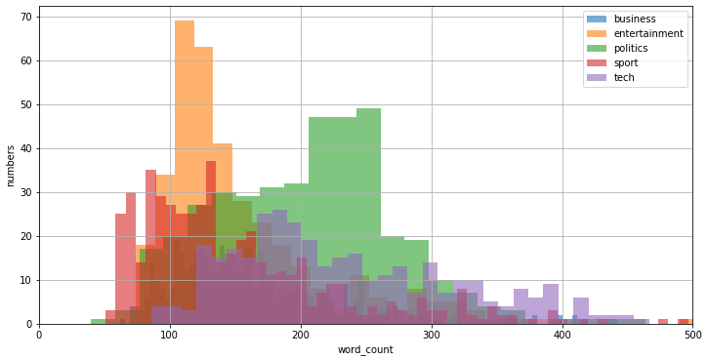
Number of words in documents

Slide 8
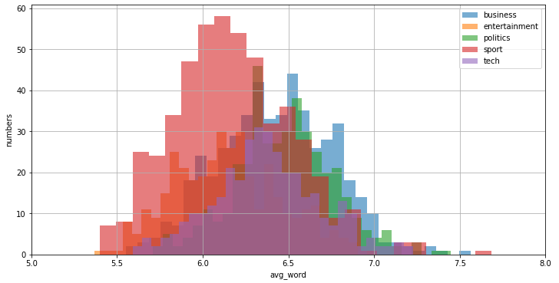
Average number of words in documents

Slide 9
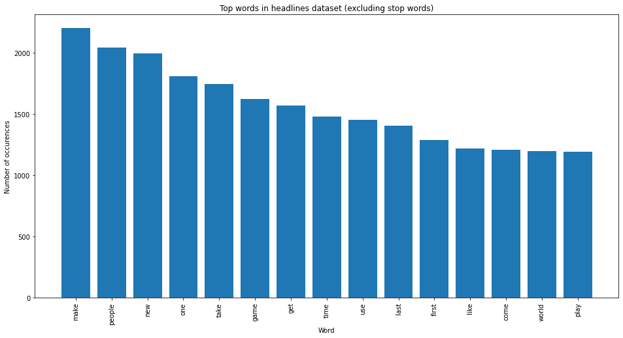
Frequent words in all documents

Slide 10

WordCloud - Business

Slide 11
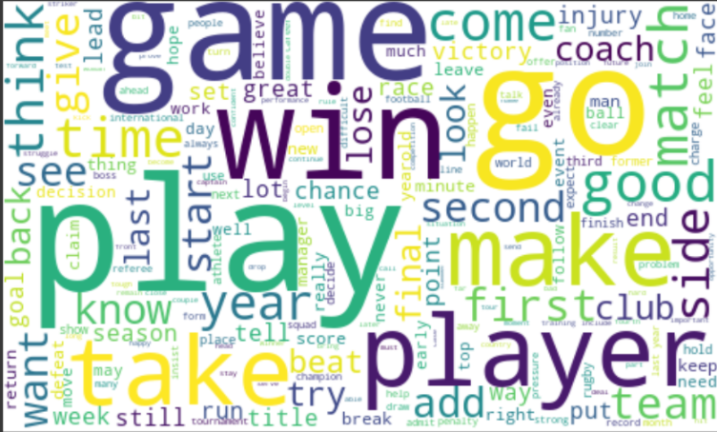
WordCloud - Sport

Slide 12
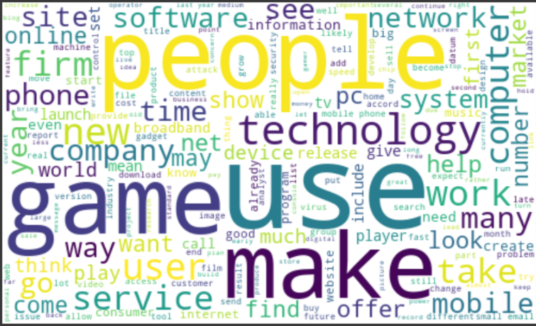
WordCloud - Tech

Slide 13
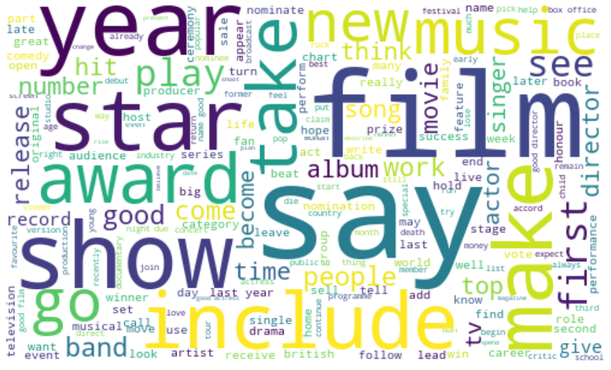
WordCloud - Entertainment

Slide 14
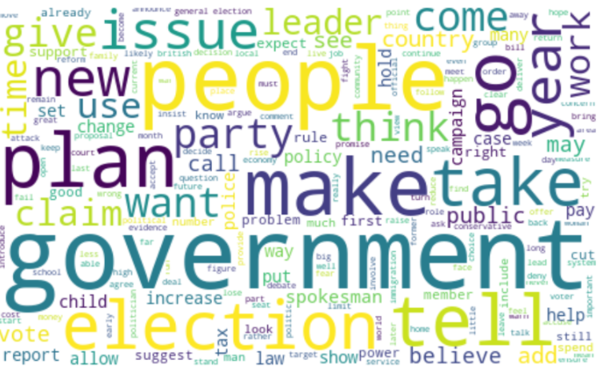
WordCloud - Politics

Slide 15
Implementation of ML Models
Latent Dirichlet Allocation (LDA) (Sklearn) with TF-IDF vectorizer
Latent Dirichlet Allocation (Sklearn) with count-vectorizer and Bi-gram
Latent Dirichlet Allocation (Gensim)
Latent Semantic Analysis (LSA)
Non-negative Matrix Factorization (NMF)

Slide 16
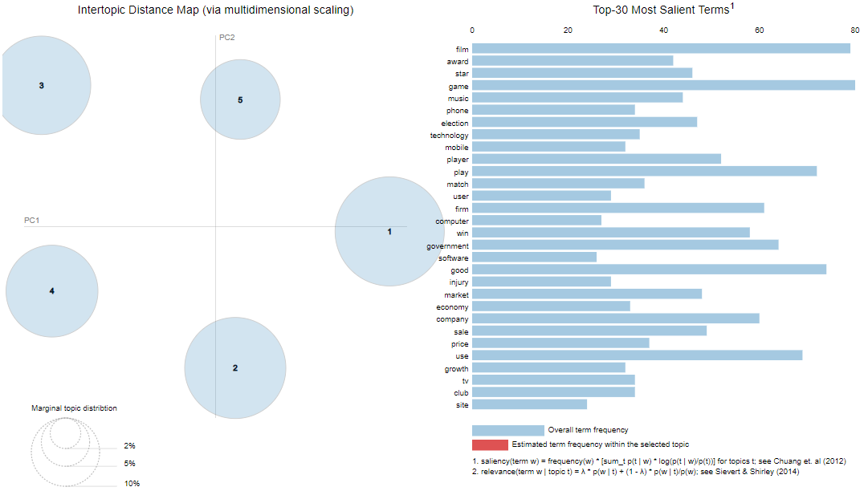
Latent Dirichlet Allocation (LDA)

Slide 17
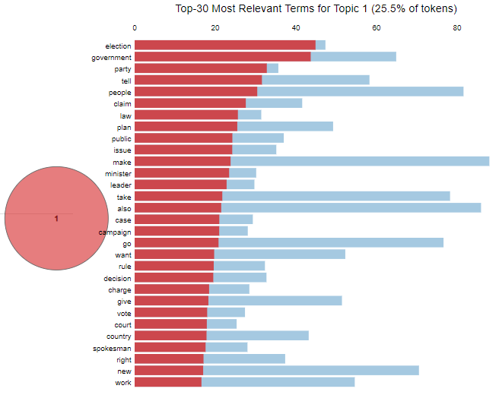
LDA - Cluster 1 : Politics

Slide 18
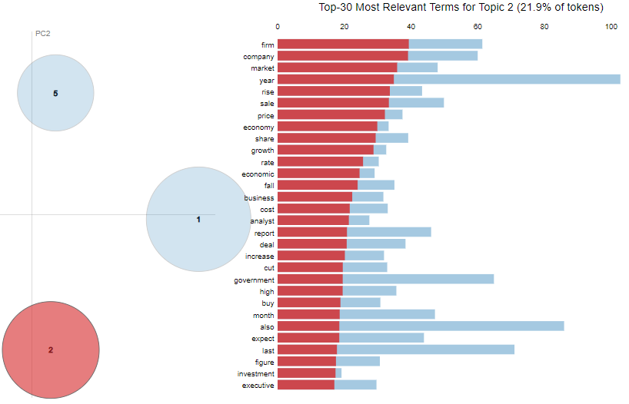
LDA - Cluster 2 : Business

Slide 19
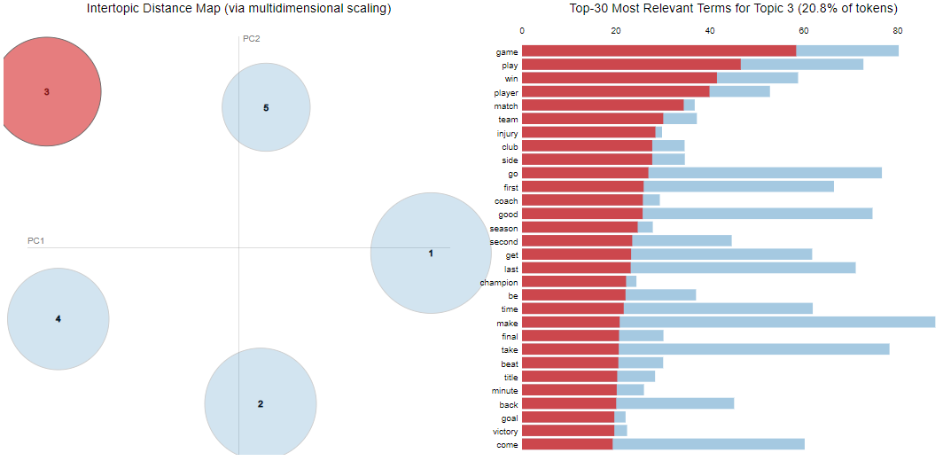
LDA - Cluster 3 : Sport

Slide 20
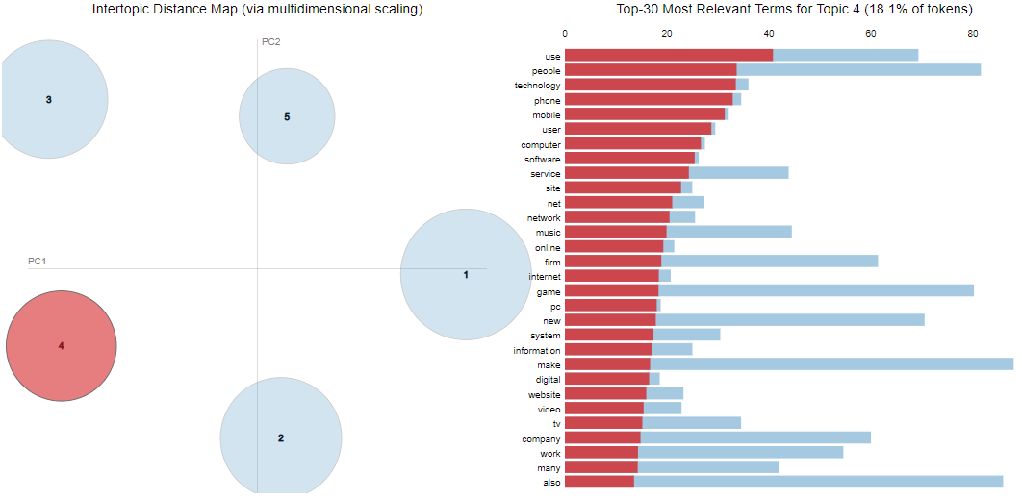
LDA - Cluster 4 : Tech

Slide 21
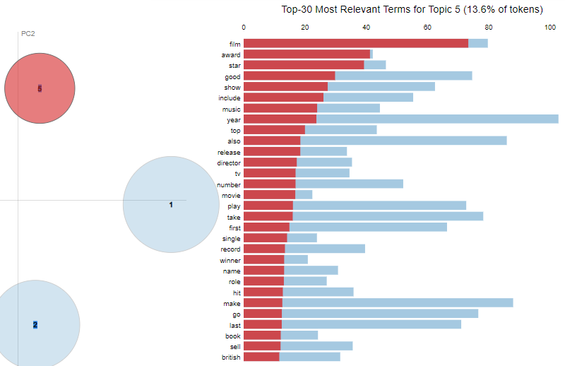
LDA - Cluster 5 : Entertainment

Slide 22
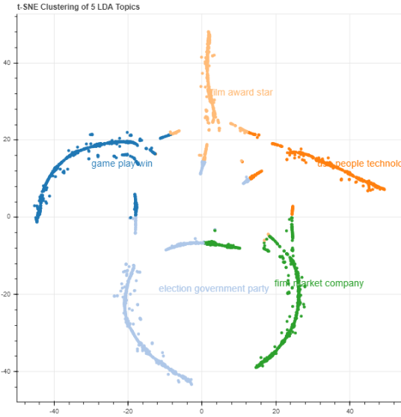
LDA - t-SNE Clustering

Slide 23
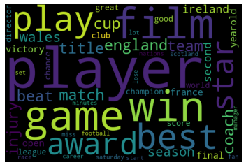
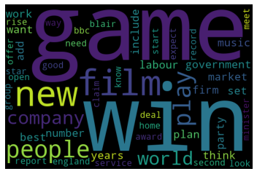
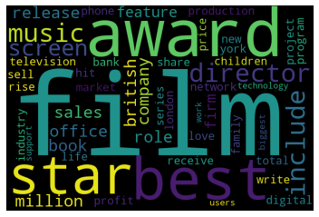
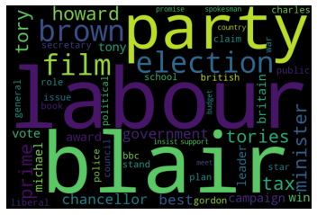
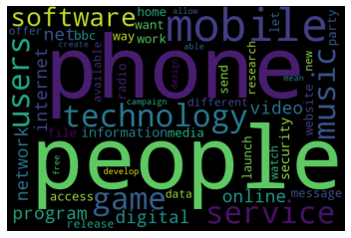
Latent Semantic Analysis (LSA)

Slide 24
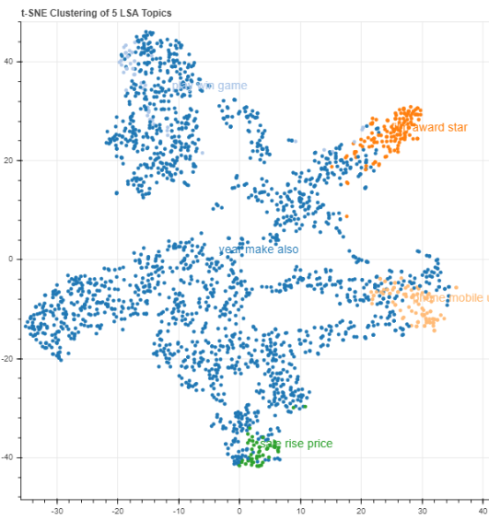
LSA - t-SNE Clustering

Slide 25
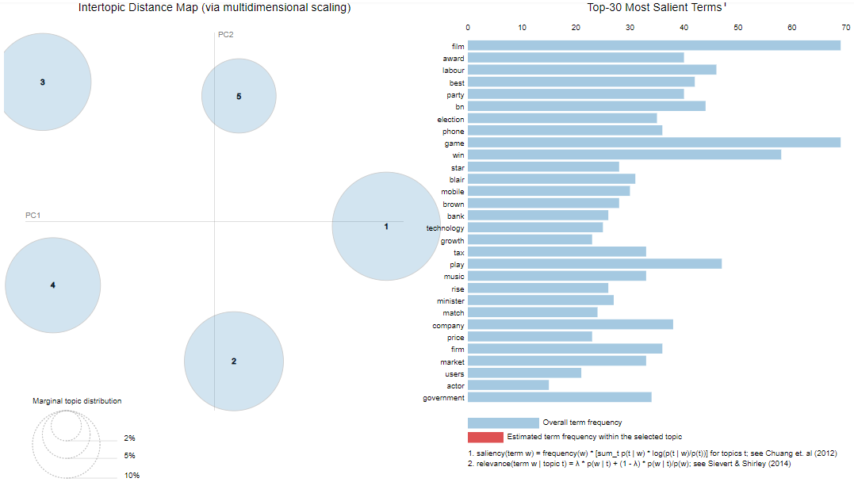
Non-negative Matrix Factorization (NMF)

Slide 26
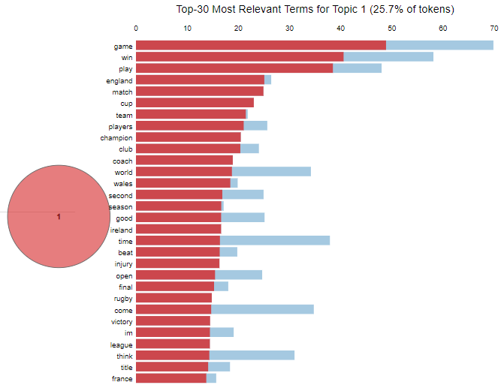
NMF - Cluster 1 : Sport

Slide 27
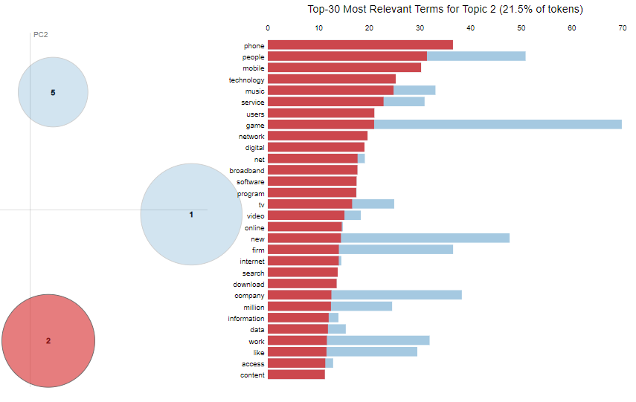
NMF - Cluster 2 : Tech

Slide 28
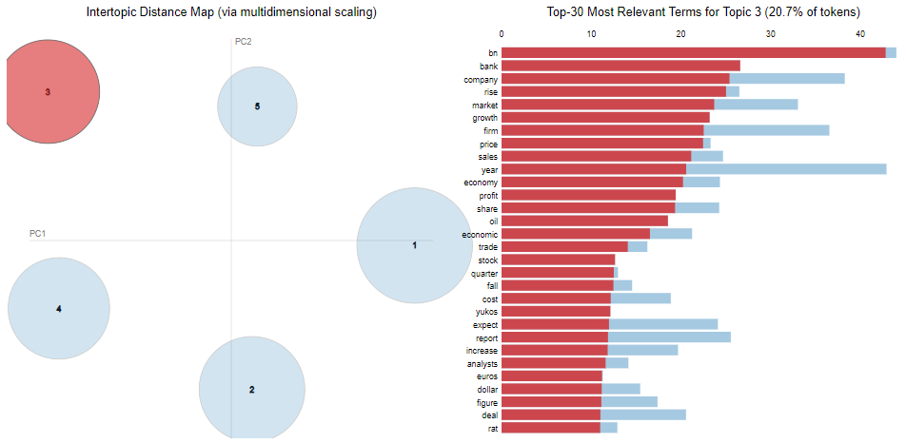
NMF - Cluster 3 : Business

Slide 29
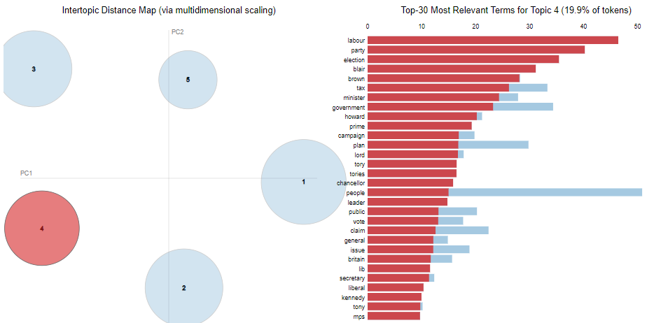
NMF - Cluster 4 : Politics

Slide 30
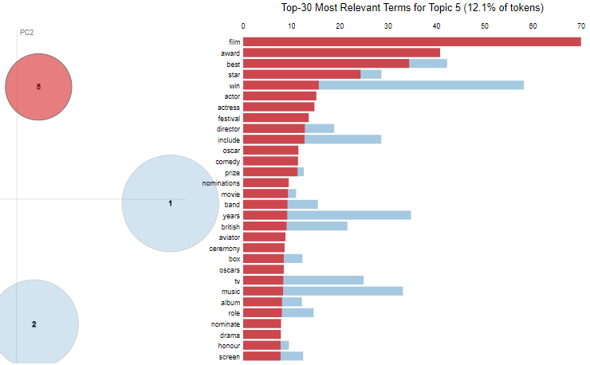
NMF - Cluster 5 : Entertainment

Slide 31
Challenges
Must read 2000+ text files and formulate a Dataset to work with.
Some text pre-processing technique took too much time to execute (autocorrect)
Limited visualization techniques to identify model performance
Less availability of information of different algorithms implementation technique in python.

Slide 32
Conclusion
LDA (Sklearn) with TF-IDF vectorizer along with NMF were best to identify the 5 given clusters.
Scope of implementing neural network in future.
As a future work, using one of the topic modeling algorithms, we can implement various applications for recommending research articles, analyzing news articles etc, which can be used for segregation of documents from topic

Slide 33
Q & A

